Slide 1

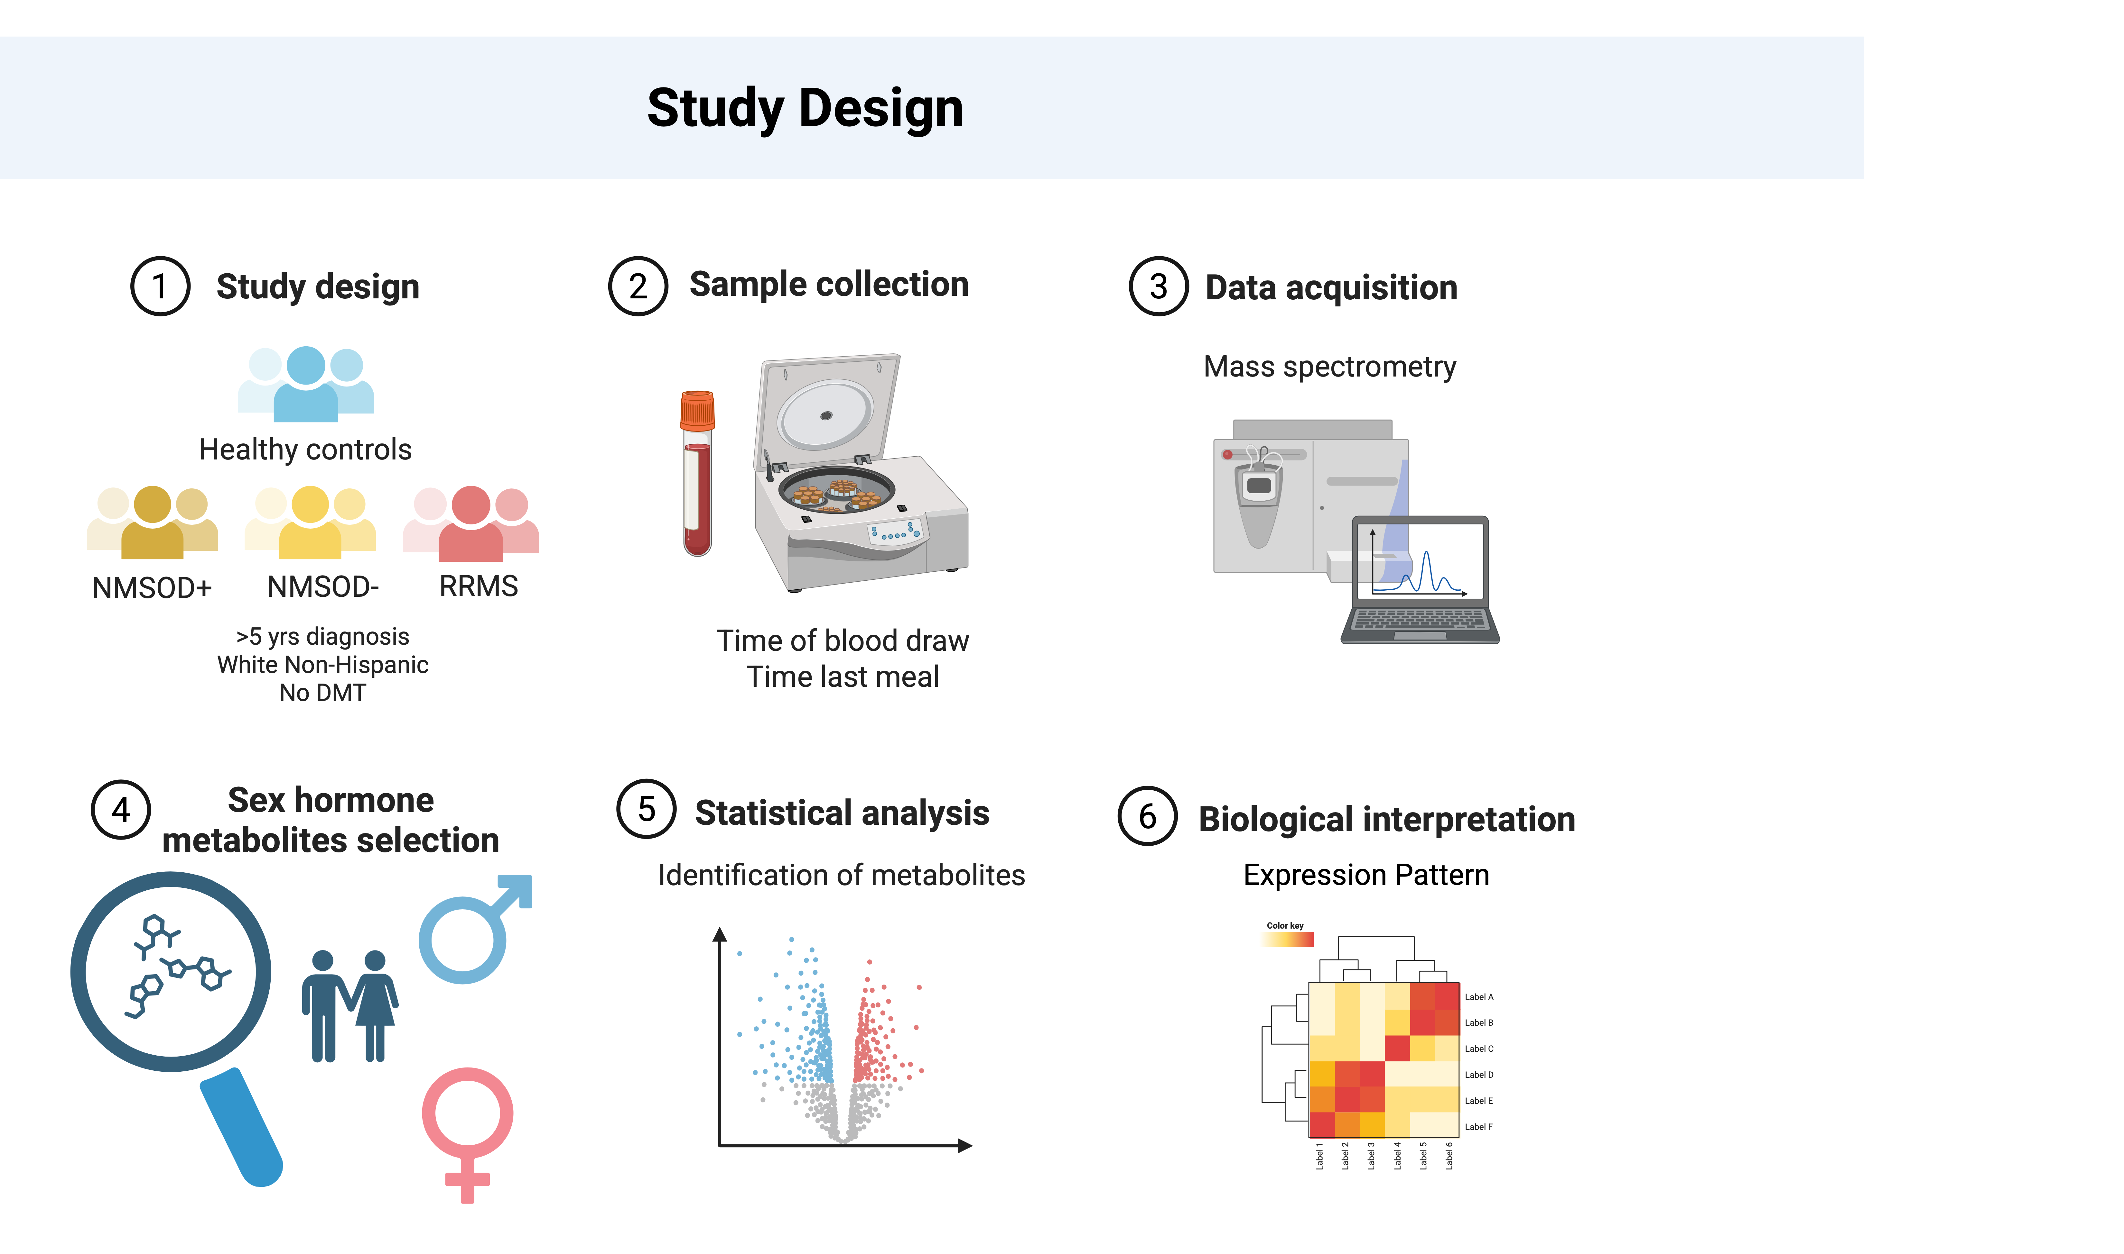
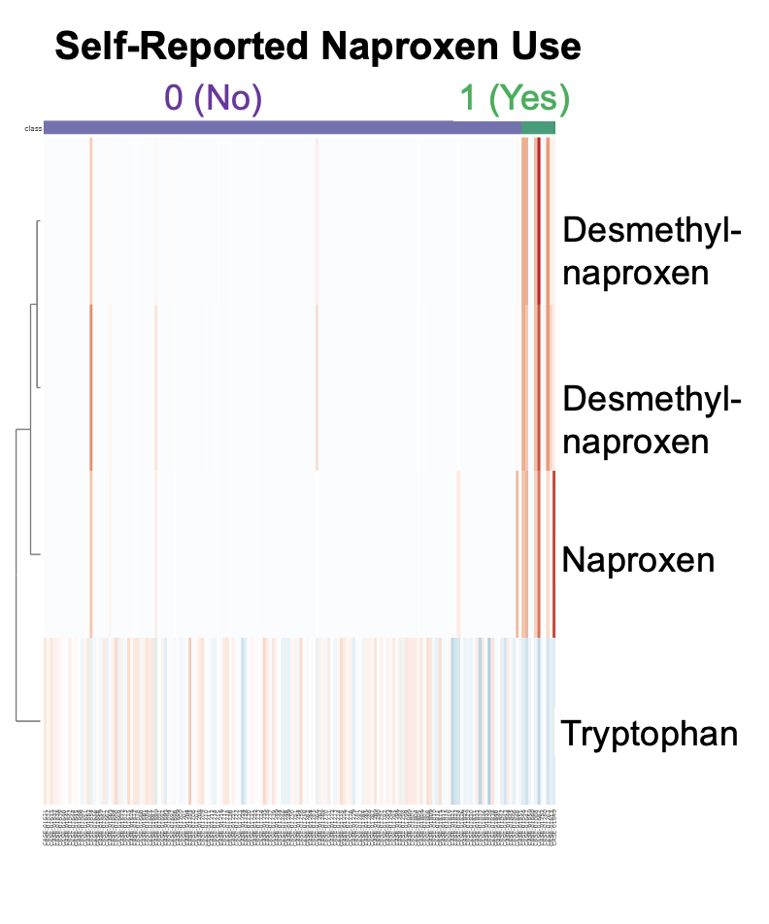
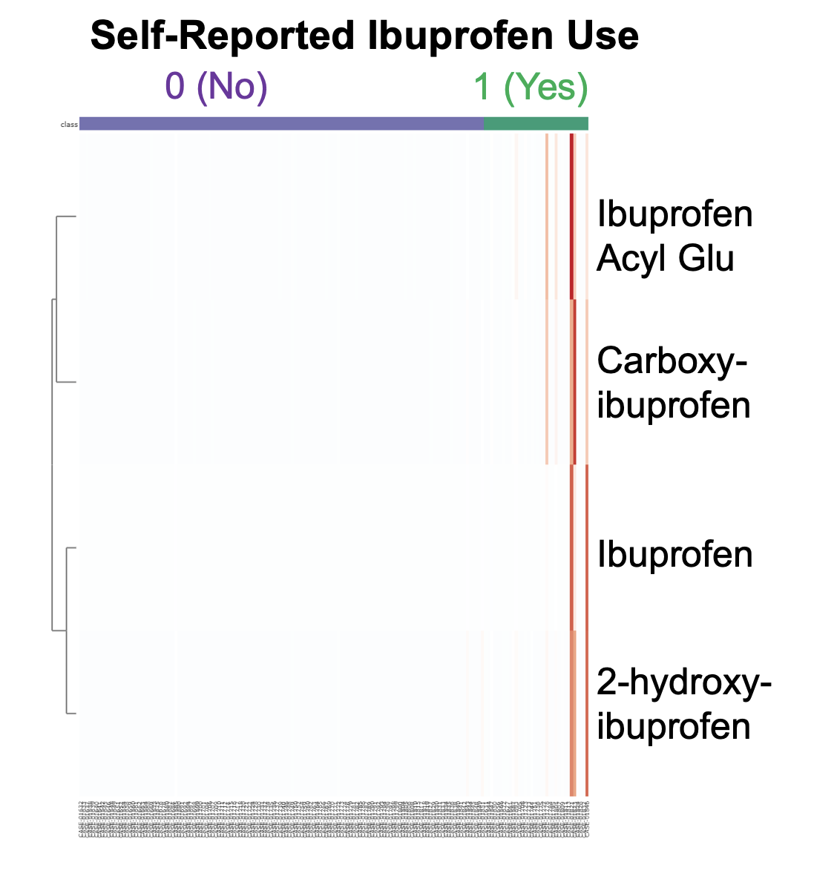
Metabolomic Profiling Reveals Early Sex-Dependent Hormonal Alterations in Multiple Sclerosis and Neuromyelitis Optica Spectrum Disorder.
Christine B. Ryan, PhD¹, Flavia Nelson, MD², Mary Davis, PhD³, Jacob L McCauley, PhD⁴, Lilyana Amezcua, MD⁵, Farren B S Briggs, PhD ScM¹
Department of Public Health Sciences, Leonard M. Miller School of Medicine, University of Miami, Miami, FL, USA
Department of Neurology, University of Miami Miller School of Medicine, Miami, FL, USA
Department of Microbiology and Molecular Biology, Brigham Young University, Provo, UT, USA
John P. Hussman Institute for Human Genomics, University of Miami Miller School of Medicine, Miami, FL, USA
Department of Neurology, Keck School of Medicine, University of Southern California, Los Angeles, CA, USA
INTRODUCTION
RESULTS
Sex-specific differences in disease susceptibility, progression, and pathogenesis have long been observed in demyelinating diseases such as multiple sclerosis (MS) and neuromyelitis optica spectrum disorder (NMOSD). Prior research has shown distinct patterns of individual sex hormones, including DHEA-S and estrogen- and testosterone-derivatives, across healthy controls (HC), MS cases, and NMOSD cases. However, it remains unclear whether these hormonal differences reflect underlying risk for MS or are instead consequences of disease chronicity or confounding factors.
Early-stage RRMS females showed no significant differences vs HC females, and early-stage RRMS males had elevated levels of several sex hormones compared to HC males in androgenic and progestin classes.
Early-stage NMOSD IgG- males and females had reduced levels of multiple sex hormones in the pregnenolone and androgenic class and had elevated lipid hormone precursors (i.e. cholesterol).
NMSOD IgG+ females showed reductions in androgenic and progestin classes, and minimal changes in sex hormone expression were observed in both NMSOD IgG+ males
OBJECTIVE
Comprehensively compare sex hormone profiles in MS and NMOSD, cases who are untreated and within five years of onset to HC.
METHODS
We analyzed metabolomic data from non-Hispanic white HC (n=106), relapsing-remitting MS (RRMS, n=75), and AQP4-antibody positive and negative NMOSD cases (NMOSD IgG+, n=18; NMOSD IgG-, n=17). Cases were DMT-naive or free (>90 days), ≤5 years from onset. Levels of 46 sex hormones were analyzed by fixed-effects linear regression with case status vs HC as the primary predictor and adjusting for likely confounders including menstrual/menopausal/sex status, hormone therapy or birth control, steroid use, time of day, fasting duration, BMI, age, smoking history, and statin use. Sex-stratified models were also conducted.
STUDY DESIGN
 | M (n) | F (n) | Age (±SD) | Dx duration (±SD) | Ever smoker | BMI | DMT naive
HC | 30 | 76 | 41.0 ± 11.8 | - | 34.0% | 27.1 (5.9) | -
RRMS | 16 | 57 | 38.8 ± 10.0 | 1.2 (1.2) | 47.9% | 27.0 (5.8) | 95.9%
NMOpos | 6 | 12 | 49.4 ± 14.1 | 0.7 (1.1) | 33.3% | 27.9 (5.2) | 55.6%
NMOneg | 8 | 9 | 41.3 ± 13.2 | 1.7 (1.4) | 47.1% | 29.5 (5.8) | 41.2%
Table 1: Sample Characteristics
Figure 2: Heat map of sex hormone metabolite expression demonstrates distinct patterns across RRMS, NMSOD antibody positive (NMOpos), and antibody negative (NMOneg) disease states compared to the respective sex-stratified HC. Expression values are represented by β-values. Asterisks (*) indicate significant (p<0.05) increase (darker color) or decrease (lighter color) in the corresponding metabolite. Metabolites are annotated by classes including androgens, estrogens, pregnenolones, progestins and lipids/sterols.
A
B
CONCLUSIONS
By focusing on early-stage, treatment-naïve/free RRMS and NMOSD cases and adjusting for key confounders, our findings suggest that early sex-specific alterations in hormone metabolism may contribute to differences in disease mechanisms and clinical presentation across sexes. These metabolic shifts may reflect underlying neuroendocrine dysregulation or downstream effects of broader lipid remodeling across disease states. Together, these insights enhance our understanding of sex differences in demyelinating disease and may help inform the development of sex-specific biomarkers and targeted therapeutic strategies.
ACKNOWELDGEMENTS
Figure 1: Cross-validating metabolomic assay and self-report. A. Metabolites significantly associated with self-reported naproxen use in the past day. B. Metabolites significantly associated with self-reported ibuprofen use in the past day.
Thank you to the participants in the Accelerated Cure Project for Multiple Sclerosis. This work was supported by NIH/NINDS R01NS121928 and The Sumaira Foundation’s SPARK Grant Award.

Slide 2
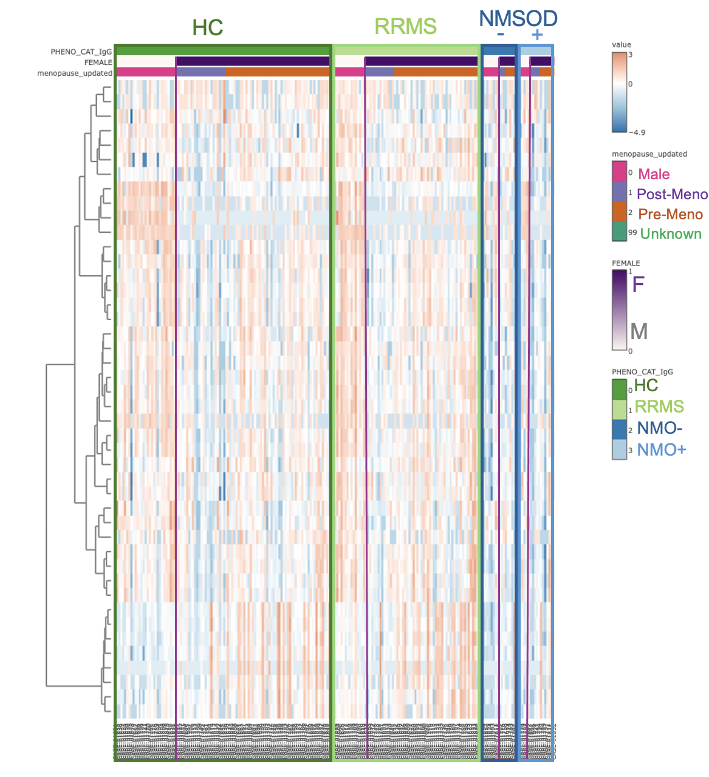
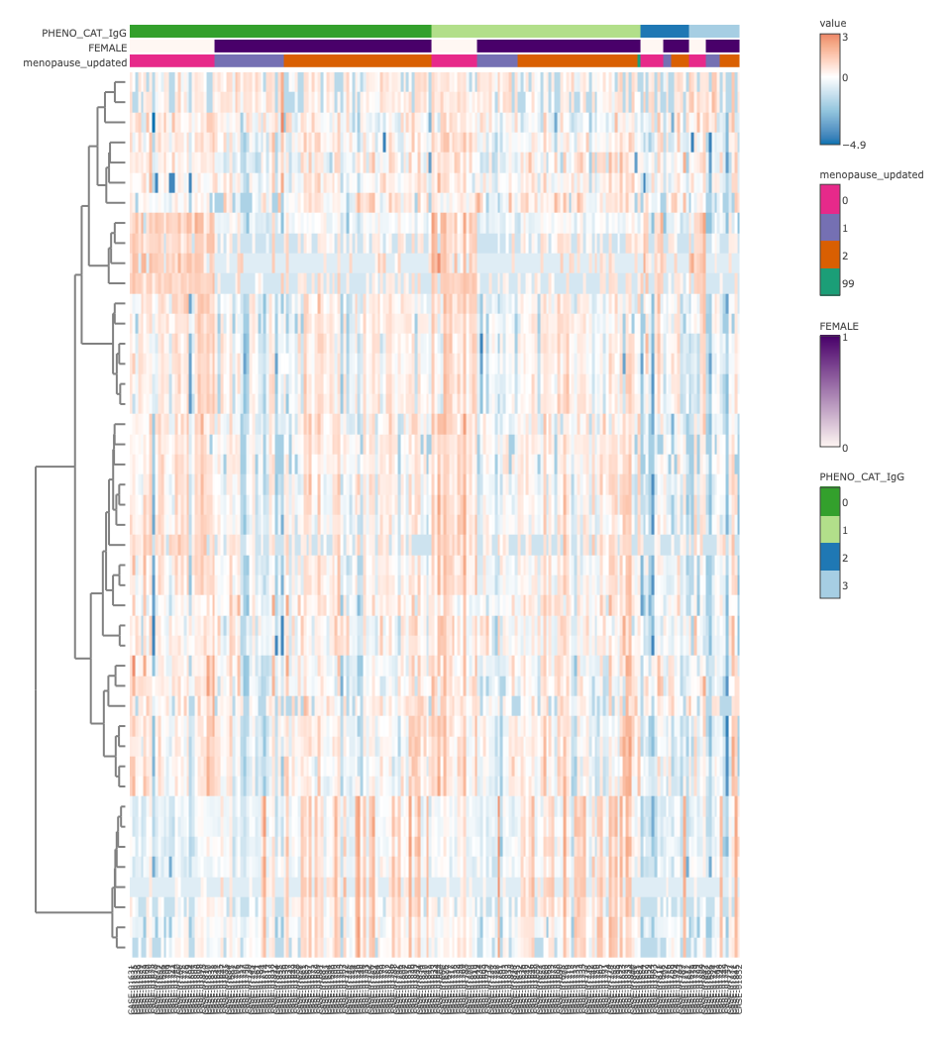
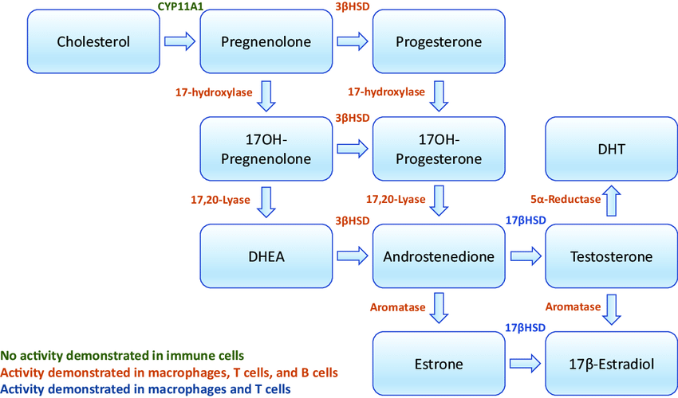
HC
RRMS
NMSOD
-
+
Male
Post-Meno
Pre-Meno
Unknown
F
M
HC
RRMS
NMO-
NMO+

Slide 3
Correlation between ACP and Mayo Beta values. Each dot represents a different metabolite

