Slide 1
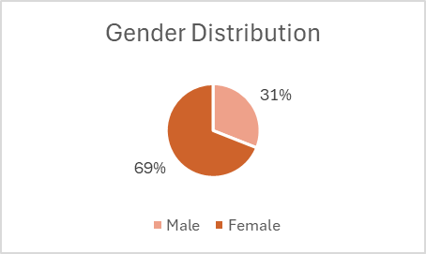
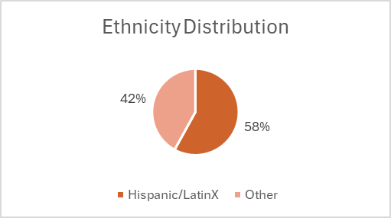
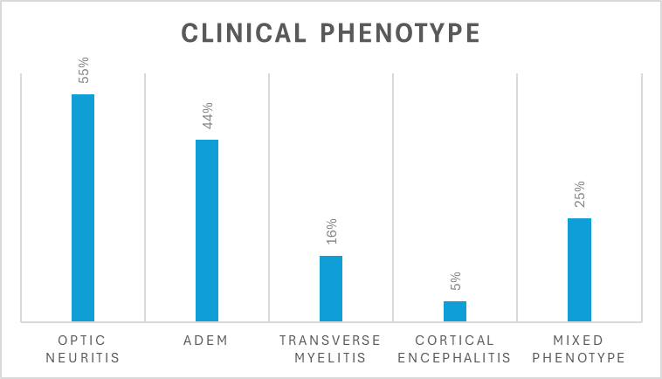
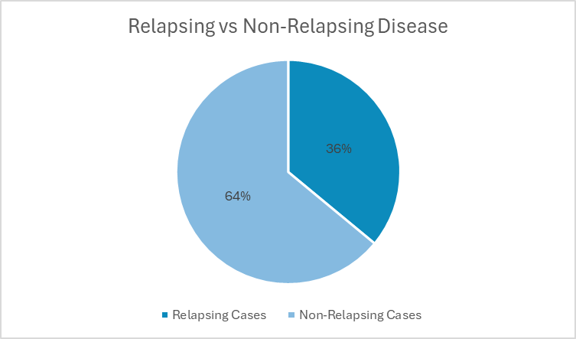
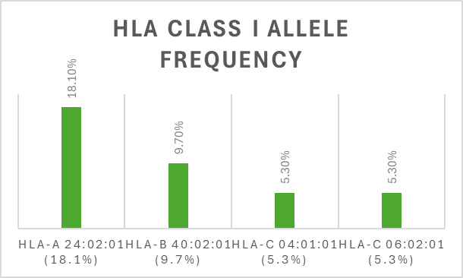
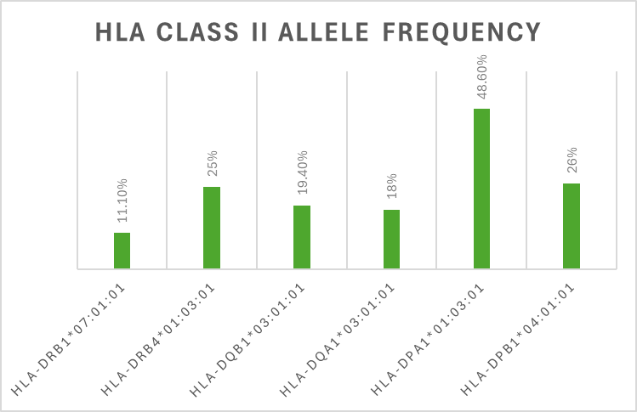
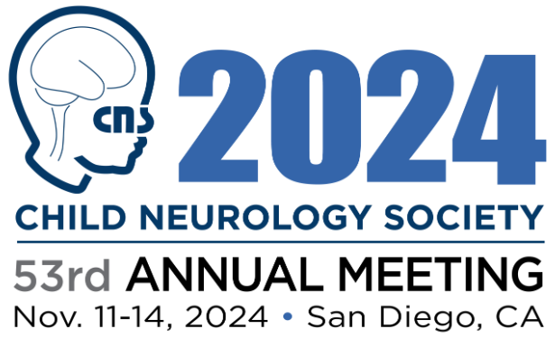
HLA Types Associated with Myelin Oligodendrocyte
Glycoprotein Antibody Disease (MOGAD)
Nusrat Ahsan MD^{1,2}, Jonathan Santoro MD^{1,2}, Laura Saucier MD^{1,2}, Wendy Mitchell MD^{1,2}, and Saba Jafarpour MD^{1,2}
Division of Neurology, Department of Pediatrics, Children’s Hospital of Los Angeles, Los Angeles, CA1, Keck School of Medicine at the University of Southern California, Los Angeles, CA2
OBJECTIVE
RESULTS
To prospectively investigate the association between specific HLA types and the risk of relapse in children diagnosed with Myelin Oligodendrocyte Glycoprotein Antibody-Associated Disease (MOGAD).
1
Patient Demographics
BACKGROUND
Myelin Oligodendrocyte Glycoprotein Antibody Associated disorder (MOG-AD) is a recently identified disease entity associated with antibody and complement mediated inflammatory demyelination. Individuals with this condition can be of any age although there is a predilection for disease in children and young adults.
Clinical phenotypes observed include:
optic neuritis (ON)
transverse myelitis (TM)
neuromyelitis Optica spectrum disorders (NMOSD)
acute disseminated encephalomyelitis (ADEM)
Distinctive Features of MOG-AD:
While overlapping in clinical presentation with disorders like aquaporin-4-antibody-associated NMOSD, MOG-AD differs in several key aspects:
Immunotherapy Response: MOG-AD patients often have unique responses to treatment.
Relapse Rates and Prognosis: Vary significantly from other demyelinating disorders.
Pathology Mechanisms: Involves humoral immunity, complement pathways, distinct activation patterns of T-cells and NK cells.
Human leukocyte antigen (HLA) complexes play an important role in autoimmune disorders and are responsible for genetic/protein-based induction and regulation of the immune system by producing cell surface antigens encoded by genes present on the short arm of chromosome six.
2
Clinical Phenotype Distribution
3
HLA Typing Results
4
Findings
No significant association between HLA Class I or II alleles and relapsing disease was observed.
METHODS
CONCLUSIONS
A prospective study of HLA types in pediatric patients with MOGAD.
Participants: Children diagnosed with Myelin Oligodendrocyte Glycoprotein Antibody-Associated Disease (MOGAD) at a single institution.
Sample Size: 36 patients, with a median age of 13 years (IQR: 9.2-15) who met Banwell criteria for MOGAD.
Sample Collection and Analysis: A buccal swab test kit was used to collect the sample. The samples were analyzed at CHLA HLA laboratory through Next Generation Sequencing.
In this small, single-institution cohort, the risk of relapse in individuals with MOGAD was not associated with specific HLA clusters.
Acknowledgement: This research was made possible by the generous support of the Sumaira Foundation through the TSF Unicorn Grant. I extend my deepest gratitude for their commitment to advancing knowledge in this field and for their invaluable support.
References:
1. Banwell B, et al. Diagnosis of myelin oligodendrocyte glycoprotein antibody-associated disease: International MOGAD Panel proposed criteria. *Lancet Neurol.* 2023 Mar;22(3):268-282. doi: 10.1016/S1474-4422(22)00431-8. Epub 2023 Jan 24. PMID: 36706773.
2. Sun X, et al. Myelin oligodendrocyte glycoprotein-associated disorders are associated with HLA subtypes in a Chinese paediatric-onset cohort. *J Neurol Neurosurg Psychiatry.* 2020 Jul;91(7):733-739. doi: 10.1136/jnnp-2019-322115. Epub 2020 May 19. PMID: 32430437; PMCID: PMC7361006.
3. Grant-Peters M, et al. No strong HLA association with MOG antibody disease in the UK population. *Ann Clin Transl Neurol.* 2021 Jul;8(7):1502-1507. doi: 10.1002/acn3.51378. Epub 2021 May 15. PMID: 33991459; PMCID: PMC8283171.
4. Bruijstens AL, et al. HLA association in MOG-IgG- and AQP4-IgG-related disorders of the CNS in the Dutch population. *Neurol Neuroimmunol Neuroinflamm.* 2020 Mar 20;7(3):e702. doi: 10.1212/NXI.0000000000000702. PMID: 32198229; PMCID: PMC7136059.

