Slide 1
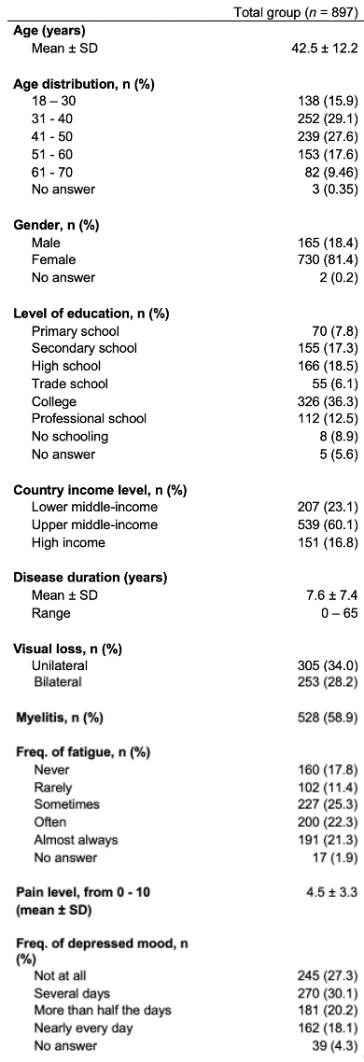
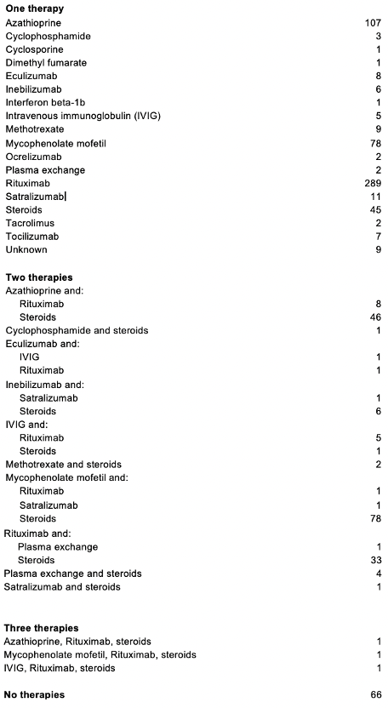
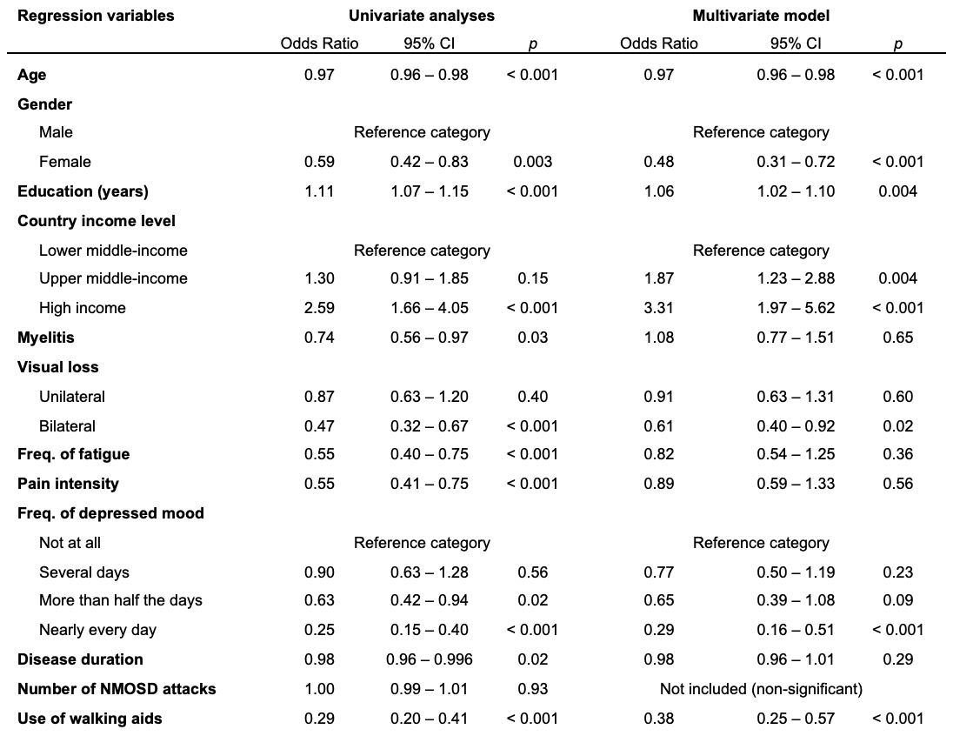
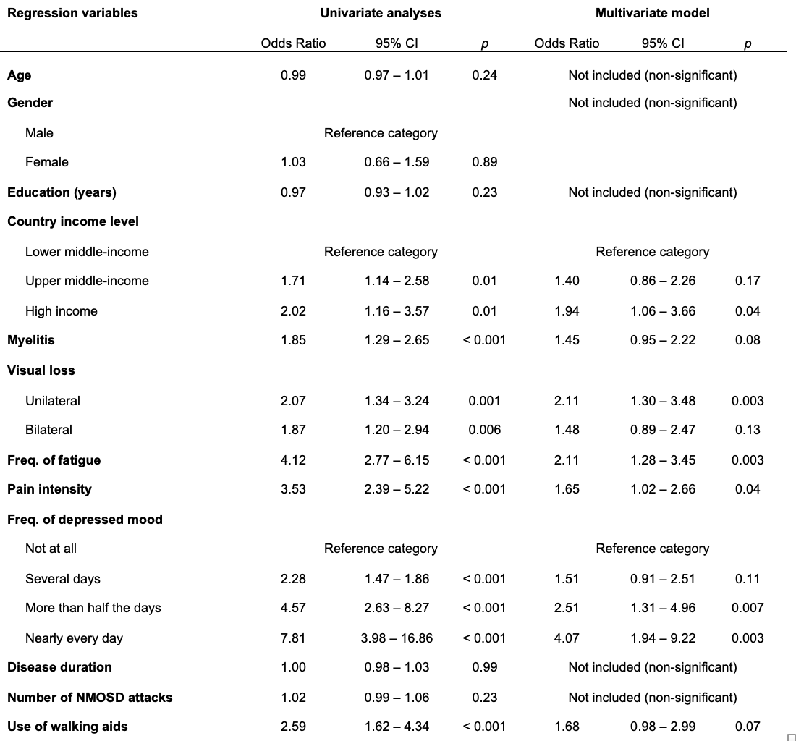
Underemployment, Work Hour Reduction, and Income Loss: An International, Multi-Centered, Cohort Study of Neuromyelitis Optica Spectrum Disorder
Andrew Siyoon Ham¹, Isabella Gomez Hjerthen¹, Decai Tian², Hongfei Gu³, Wen Gao⁴, Akshatha Sudhir⁵, Lekha Pandit⁵, Y. Muralidhar Reddy⁶, Jagarlapudi Muralikrishna Murthy⁶, Sharareh Eskandarieh⁷, Mohammad Ali Sahraian⁷, Saeideh Ayoubi⁷, Roberto Rodríguez Rivas⁸, Francisco González-González⁸, José de Jesús Flores Rivera⁸, Enedina Oliveira⁹, Raquel Paiva Portugal⁹, Paloma Peter Travassos Zaidan⁹, Shanthi Viswanathan¹⁰, Karina Koh¹¹, Su-Yin Lim¹², Punchika Kosiyakul¹³, Jiraporn Jitprapaikulsan¹³, Sasitorn Siritho¹³, Saúl Reyes^{14,15,16}, Jaime Toro^{14,15,17}, Jairo Gaitán^{14,15}, Deyanira Ramirez¹⁸, Raúl Comme¹⁸, Josmarlin Medina Baez¹⁸, Maria Castillo¹⁹, Ibis Soto¹⁹, Sandra Mendoza de Salazar²⁰, Omaira Molina²¹, Amany Hussein Ragab²², Amr Mohamed Fouad²², Nirmeen Adel Kishk²², Juan Ignacio Rojas²³, Edgardo Cristiano²⁴, Liliana Patrucco²⁴, Bade Güleç²⁵, Ugur Uygunoglu²⁵, Melih Tutuncu²⁵, Aksel Siva²⁵, Amelia Yun Yi Aw²⁶, Kevin Tan²⁶, Tianrong Yeo^{26,27,28}, Raed Alroughani²⁹, Samar Farouk Ahmed³⁰, Malak Almojel²⁹, Jera Kruja³¹, Ariola Verlaku³¹, Olga Qirjako³¹, Riwanti Estiasari^{32,33}, Kartika Maharani^{32,33}, Saif Huda³⁴, Patricia Kelly³⁴, Raffaele Iorio³⁵, Eleonora Sabatelli^{35,36}, Alvaro Cobo-Calvo^{37,38}, Georgina Arrambide^{37,38}, Javier Villacieros Álvarez^{37,38}, Simon Broadley³⁹, Unnah Leitner³⁹, Fodé Abass Cissé⁴⁰, Mohamed Lamine Touré⁴⁰, Kab Conde⁴⁰, Farrah Mateen¹
¹ Massachusetts General Hospital, Neurology, Boston, United States, ² Beijing Tiantan Hospital, Capital Medical University, Department of Neuroimmunology, Beijing, China, ³ Hongmian Cancers and Rare Disorders Charity Foundation of Guangzhou , Beijing, China
⁴ Hongmian Cancers and Rare Disorders Charity Foundation of Guangzhou, Xiangyang, China, ⁵ Nitte University, Centre for Advanced Neurological Research, Mangalore, India, ⁶ CARE Institute of Neurological Sciences, Department of Neurology, Hyderabad, India, ⁷ Multiple Sclerosis Research Center, Neuroscience Institute, Tehran University of Medical Sciences, Tehran, Iran, ⁸ Instituto Nacional de Neurología y Neurocirugía, Department of Neuroimmunology, Mexico City, Mexico, ⁹ Universidade Federal de Sao Paulo, Department of Neurology, São Paulo, Brazil, ¹⁰ Kuala Lumpur Hospital, Neurology, Kuala Lumpur, Malaysia, ¹¹ Kuala Lumpur Hospital, Clinical Research Centre, Kuala Lumpur, Malaysia, ¹² School of Medicine, Faculty of Health and Medical Sciences, Taylor's University, Kuala Lumpur, Malaysia, ¹³ Division of Neurology, Department of Medicine, Faculty of Medicine Siriraj Hospital, Mahidol University, Bangkok, Thailand, ¹⁴ Fundación Santa Fe de Bogotá, Neurology, Bogotá, Colombia, ¹⁵ School of Medicine, Universidad de los Andes, Bogotá, Colombia, ¹⁶ Blizard Institute, Barts and The London School of Medicine and Dentistry, Queen Mary University of London, London, United Kingdom, ¹⁷ School of Medicine, Universidad El Bosque, Bogotá, Colombia, ¹⁸ Hospital Padre Billini, Neurology, Santo Domingo, Dominican Republic, ¹⁹ Hospital Clinico , Neurology, Maracaibo, Venezuela, ²⁰ CHET, Department of Neurology, Valencia, Venezuela, ²¹ Hospital Universitario, Neurology, Maracaibo, Venezuela, ²² Cairo University, Neurology, Cairo, Egypt, ²³ Hospital Universitario de CEMIC, Neurology, Buenos Aires, Argentina, ²⁴ Centro de Esclerosis Multiple de Buenos Aires, Multiple Sclerosis, Buenos Aires, Argentina, ²⁵ Istanbul University Cerrahpasa-Cerrahpasa School of Medicine, Neurology, Istanbul, Turkey, ²⁶ National Neuroscience Institute, Department of Neurology, Singapore, Singapore, ²⁷ Duke-NUS Medical School, Singapore, ²⁸ Lee Kong Chian School of Medicine, Nanyang Technological University, Singapore, ²⁹ Amiri Hospital, Kuwait, Kuwait, ³⁰ Ibn Sina Hospital, Neurology, Kuwait, Kuwait, ³¹ University of Medicine, UHC Mother Teresa, Neurology, Tirana, Albania, ³² Universitas Indonesia, Neurology, Jakarta, Indonesia, ³³ Cipto Mangunkusumo Hospital Jakarta, Neurology, Jakarta, Indonesia, ³⁴ Walton Centre NHS Foundation Trust, Neurology, Liverpool, United Kingdom, ³⁵ Fondazione Policlinico Universitario A. Gemelli IRCCS, UOC Neurologia, Rome, Italy, ³⁶ Dipartimento Di Neuroscienze, Università Cattolica del Sacro Cuore, Rome, Italy, ³⁷ Vall d’Hebron Institut de Recerca, Vall d’Hebron Hospital Universitari. Universitat Autònoma de Barcelona, Barcelona, Spain, ³⁸ Servei de Neurologia-Neuroimmunologia, Centre d’Esclerosi Múltiple de Catalunya (Cemcat), Barcelona, Spain, ³⁹ School of Medicine and Dentistry, Griffith University, Gold Coast, Australia, ⁴⁰ Ignace Deen Teaching Hospital, University Gamal Abdel Nasser, Neurology, Conakry, Guinea
Introduction & Objectives
Results
Approximately 170,000 people worldwide have neuromyelitis optica spectrum disorder (NMOSD), an inflammatory autoimmune disease of the central nervous system with a relatively low prevalence of 0.5–4/100,000. Both cardinal symptoms of NMOSD, including visual loss and myelitis, and secondary symptoms, such as fatigue, pain, and mental health complications, can lead to cumulative and permanent disability for patients living with the disease. In turn, these deficits could impact adults of working age in work contexts, influencing their ability to work and earn income.
In this study, we aim to quantitatively characterize the economic impact of NMOSD on employment, work hours, and wages of people living with the disease internationally. Given the significant impact of NMOSD on the central nervous system, we hypothesize that working adults with NMOSD will experience higher proportions of unemployment, reduced working hours, and loss of personal income. Moreover, as the disease predominantly affects women, we also aim to delve deeper into the demographic and clinical variables that are associated with socioeconomic outcomes. This could better inform comprehensive and practical approaches to disease treatment that allow the preservation of a person’s socioeconomic functioning in society.
Demographic Variables: The study analyzed 897 participants with NMOSD (81.4% female, mean enrollment age 42.5 ± 12.2 years, mean disease duration 7.6 ± 7.4 years) (Table 1). Participants had 12.6 ± 4.4 years of formal schooling on average, and 27 (3.0%) were current students. 207 participants (23.1%) were from lower middle-income countries, 539 (60.1%) from upper middle-income countries, and 151 (16.8%) were from high-income countries.
Clinical picture: The mean age at diagnosis was 35.5 ± 12.0 years, with a mean age at onset of 34.1 ± 18.1. Since diagnosis, the median number of attacks was two. 635 (72.2%) participants were AQP-4 antibody positive, while the remainder were double-seronegative. Visual loss was common, with 305 participants (34.0%) experiencing unilateral loss and 253 (28.2%) losing vision in both eyes. 58.9% indicated living with myelitis, and 34.5% actively used walking aids. The average pain level (on a scale of 0 to 10) was 4.5 ± 3.3, and 57.0% reported that pain impacted their ability to work. 391 (43.6%) suffered from frequent fatigue, and 343 (38.3%) also underwent frequent periods of depressed mood. Most patients (92.6%) received treatment with immunosuppressive agents, steroids, and immunoglobulins (Table 2).
Socioeconomic: Before being diagnosed with NMOSD, 562 participants (62.7%) were employed, which decreased to 326 (36.3%) post-diagnosis. This trend persisted across genders, with rates decreasing from 75.6% to 46.7% for men and 60.2% to 34.2% for women post-diagnosis (Table 3). Average work hours decreased from 32.8 hours to 16.3 hours per week after NMOSD diagnosis, with 379 (42.3%) losing work and 521 (58.1%) reducing work hours. 48.9% of respondents stated that their employers were aware of their diagnosis. 321 (35.8%) received health insurance from work, and of those, 264 (82.2%) cited it as the reason for continuing employment. Although 48.3% reported wage losses after diagnosis, the median income increased from 4878.10 international dollars to 7022.18 international dollars without accounting for inflation.
Model building and regression analyses: Upon univariate analysis, younger age, being male, years of education, residence in upper middle-income and high-income countries, not having bilateral visual loss, not having frequent episodes of depressed mood, and non-use of walking aids were predictors of employment. On a similar analysis for lost or reduced work hours, higher levels of pain, unilateral visual loss, and higher frequencies of fatigue, and depressed mood were all significant predictors of a participant having lost or reduced their work hours (Table 4b). Residence in a high-income country was also a predictor of lost or reduced work hours. Wage analysis showed that disease duration was positively associated with increased income between pre- and post-NMOSD diagnosis, while older age and the highest frequency of depressed mood were predictive of wage decrease.
Methods
Ethics: Approved by the Massachusetts General Brigham Institutional Review Board. Additional approvals by the local ethics board, as needed.
Study Site: Participants were recruited from clinical sites in 23 countries between April 2022 and August 2023. Recruitment was conducted through neurologist referrals.
Data Collection: Adults aged 18-70 years old with neurologist-diagnosed NMOSD completed a one-time survey. Data collected included demographic and clinical characteristics and employment-related losses attributable to NMOSD.
Data Analysis: Descriptive statistics, including means, medians, ranges, and percentages, were used to depict the group’s characteristics. Univariate analyses were conducted on selected demographic and clinical variables, such as age, gender, education, and clinical symptoms like visual loss, frequency of depressed mood, pain level, and disease duration. Certain clinical variables, such as pain level and the impact of depressed mood on job-related duties, were binarized into presence/absence categories for clearer statistical comparisons. Data analyses were conducted using R (Version 4.3.1).
Table 1. Demographic and clinical variables
Table 2. Current therapies and therapy combinations used by NMOSD patients
Table 4a. Logistic regression model - likelihood of employment
Table 4b. Logistic regression model - likelihood of work hours loss/reduction
Discussion & Conclusion
Our study was primarily limited by using non-population-based sampling, relying on self-reported data from participants with access to neurological care. Employment, work hours, and wage data may thus present a more favorable picture than the general NMOSD population. Cultural and legal differences across countries may have also affected the trends in employment, work hours, and wages post-diagnosis, as well as a gender imbalance in our cohort due to the higher frequency of NMOSD in women. Our analysis of wages and income was limited by the omission of many potential influencers of such figures, including inflation and career progression.
Despite these limitations, we investigate issues of employment and income in NMOSD that have not previously been studied in depth. NMOSD is a relatively rare disease, and we present a large international cohort of patients, which can lend insights into actual lived experiences and collective outcomes of people with NMO. Although there are country-level differences, our findings identify significant impacts from the debilitating symptoms of NMOSD, regardless of country of origin. “Invisible symptoms” such as fatigue and depression are universal, making them critical to consider when administering clinical care. Earlier interventions to help patients maintain employment, considering the demonstrable impact of disease diagnosis on working ability, should be pursued. Despite being a relatively well-treated and monitored cohort of NMOSD, we find that the disease significantly and negatively impacts patients’ likelihood of maintaining employment, work hours, and wages, highlighting the overlooked socioeconomic consequences of NMOSD.
Table 3. Employment rates for NMOSD participants post-diagnosis and all citizens in 2022
Funding Support: Investigator-initiated grant from Amgen; The Sumaira Foundation
Contact: Farrah Mateen, MD, PhD fmateen@mgh.harvard.edu

