Slide 1
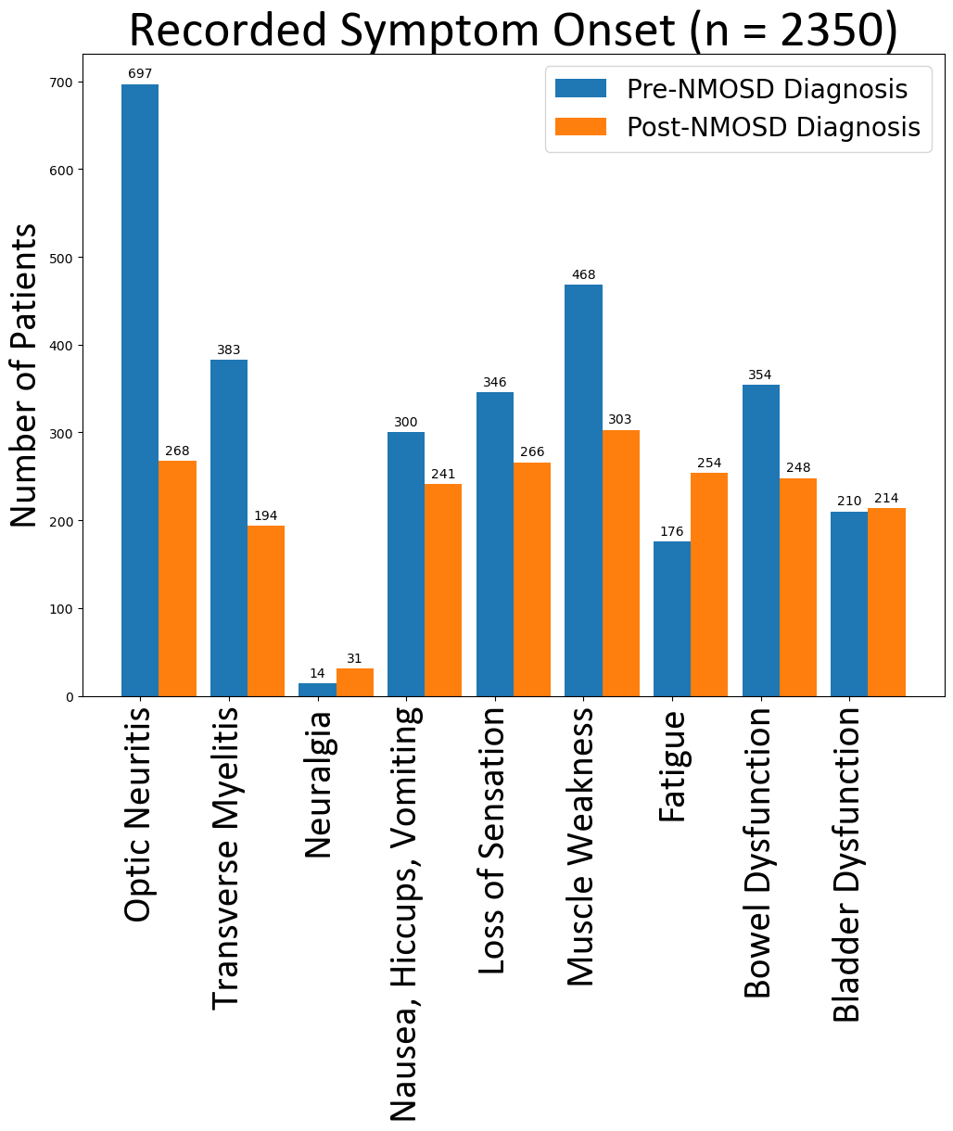
Frequency of Neuromyelitis Optica Spectrum Disorder Correlated Symptoms: A pre and post diagnosis comparison from a National Dataset
Abigail H. Sorenson^{1,2}, Esther Zeng^{1,2}, Tammy L. Smith MD, PhD²,^{3,4}, Melissa Wright MD², Aditi Sharma MD², Trieste Francis BS², John Rose MD^{2,3}, Ka-Ho Wong MBA², Stacey L. Clardy MD, PhD^{2,3}
1. University of California-Berkeley, Berkeley CA, USA 2. Department of Neurology, University of Utah, Salt Lake City UT, USA. 3. George E. Wahlen Department of Veterans Affairs Medical Center, Salt Lake City, UT. 4. ARUP Laboratories, Salt Lake City, UT
Background
Objectives
Results
Table 2: Number of days between symptom onset and NMOSD diagnosis
 | Recorded Symptom Onset Prior to Diagnosis in Days (Median, [IQR]) | Recorded Symptom Onset After Diagnosis in Days (Median, [IQR])
Optic Neuritis | 98 [26, 436] | 64 [0, 420.25]
Transverse Myelitis | 64 [16, 337] | 78 [1, 539.5]
Neuralgia | 101 [32, 496] | 520 [127.5, 1176]
Nausea, Hiccups, Vomiting | 152 [28.75, 927] | 308 [39, 801]
Loss of Sensation | 124 [27.25, 635] | 217.5 [26, 654.75]
Muscle Weakness | 88 [15.75, 597] | 196 [5.5, 654.5]
Fatigue | 202 [30, 628] | 306.5 [62.25, 875]
Bowel Dysfunction | 139 [23, 662] | 245 [17, 829.75]
Bladder Dysfunction | 86.5 [21, 300.75] | 100 [3.75, 566.25]
NMOSD is an antibody-mediated autoimmune disorder affecting the central nervous system
Common clinical characteristics include myelitis, optic neuritis, neuralgia, nausea/vomiting/ hiccups, fatigue, bowel/ bladder dysfunction
Recorded pre-diagnostic symptoms have been under investigated
Determine the most common recorded symptom diagnoses of Neuromyelitis Optica Spectrum Disorder (NMOSD) pre and post NMOSD diagnosis
Investigate potential demographic risk factors in recorded symptomology
Figure 1: number of patients with symptom onset
Results Cont.
Univariate Cox Hazard models show there is limited correlated demographic risk for recorded symptom onset after diagnosis (Table 1)
Females are less likely to have transverse myelitis onset after NMOSD diagnosis (Table 1)
More patients had a recorded symptom onset prior to diagnosis with the exclusion of neuralgia, fatigue, and bladder dysfunction (Figure 1)
The IQR ranges for symptoms generally span more than a year (Table 2)
Methods
Secondary analysis study with an NMOSD de-identified aggregate dataset with dates ranging 10/29/1978 – 07/20/2022 sourced from TriNetX
TriNetX provides access to clinical patient data from 68 US hospitals
To increase specificity patients with fewer than three NMOSD ICD-10-CM (G36.0) code entries were removed
ICD-10-CM codes were used to identify when symptoms were recorded
Univariate Cox Hazard models to determine individual demographic risk factors associated with the onset of a specific symptom recorded after NMOSD diagnosis (Table 1)
Discussion
Limitations of analysis: lack of provider information, lack of disease severity, dataset originates from an electronic health record system aggregated dataset
While optic neuritis and transverse myelitis are most investigated by neurologists and researchers, other NMOSD symptoms should be screened
Future research should be done to better quantify pre-diagnosis symptoms for accurate predictive modeling that allows neurologists to better predict an NMOSD diagnosis for early disease and symptomatic treatments
Table 1: Cox Hazard Models to identify if biological sex or race/ethnicity are potential risk factors for specific NMOSD symptoms
*= p-value < 0.05
Hazard Ratio [95% CI] | Optic Neuritis | Transverse Myelitis | Neuralgia | Nausea, Hiccups, Vomiting | Loss of Sensation | Muscle Weakness | Fatigue | Bowel Dysfunction | Bladder Dysfunction
Sex, Female | 1.099 [0.82, 1.472] | 0.675 [0.496, 0.917]* | 1 [0.432, 2.313] | 1.155 [0.844,1.581] | 0.905 [0.684, 1.197] | 0.968 [0.741, 1.265] | 1.3 [0.947, 1.784] | 1.055 [0.78, 1.426] | 0.994 [0.723, 1.367]
Race (Reference White) AI/AN Asian Black NHPI Unknown | 1.209 [0.169, 8.642] 0.993 [0.506, 1.94] 0.925 [0.699, 1.223] 2.515 [0.352, 17.98] 1.153 [0.821, 1.619] | 1.68 [0.234, 12.047] 0.641 [0.236, 1.742] 1.216 [0.891, 1.659] 0.007 [0, 1.52E+15] 0.96 [0.622, 1.482] | 0.022 [0, 1.12E+13] 0.946 [0.127, 7.049] 0.965 [0.443, 2.1] 0.032 [0, 5.21E+18] 0.598 [0.177, 2.023] | 0.004 [0, 1.87E+10] 1.215 [0.639, 2.312] 0.766 [0.567, 1.036] 0.005 [0, 5.99E+14] 0.999 [0.696, 1.433] | 0.004 [0, 1.78E+10] 0.438 [0.162, 1.182] 1.083 [0.828, 1.416] 0.005 [0, 4.43E+14] 1.008 [0.706, 1.439] | 0.996 [0.139, 7.114] 0.715 [0.335, 1.526] 1.247 [0.974, 1.597] 0.005 [0, 3.05E+14] 0.895 [0.626, 1.278] | 1.138 [0.159, 8.134] 0.659 [0.291, 1.491] 0.844 [0.636, 1.119] 0.005 [0, 4.26E+14] 0.789 [0.54, 1.153] | 2.796 [0.691, 11.304] 1.584 [0.876, 2.865] 1.055 [0.797, 1.397] 0.006 [0, 6.31E+14] 0.778 [0.519, 1.166] | 3.747 [0.925, 15.188] 1.21 [0.59, 2.484] 1.315 [0.983, 1.759] 0.006 [0, 1.05E+15] 0.676 [0.419, 1.09]

Slide 2
Supplement
ICD-10-CM Code Selection
ICD-10-CM codes utilized for identifying symptoms
Optic Neuritis: H46, H46.9, H46.13, H46.10, H46.11, H46.12, H46.1, H46.00, H46.8, H46.01, H46.02, H46.03, H46.0
Transverse Myelitis: G37.3
Neuralgia: M54.81, G50.0, G54.5
Nausea, Vomiting, Hiccups: R11.2, R11.0, R11, R06.6
Loss of Sensation: R20, R20.1, R20.2, G57.10, G57.11, G57.12, G57.1, R20.9, G57.13
Muscle Weakness: M62.81, R53.1, M62.00, M62.8
Fatigue: R53.82, R53.83
Bowel Dysfunction: R19.15, R19.11, R19.12, R19.4, R19.1, K56.1, K56.0, K59.00, K59.0, K59.09, K59.04, K59.01, K56.41, R15.0
Bladder Dysfunction: N31.9, N31, N31.8, N31.0, N31.1, N32.81
Acknowledgements
Funding was provided by the Sumaira Foundation Spark Grant and Berkeley Student Opportunity Fund

