Slide 1
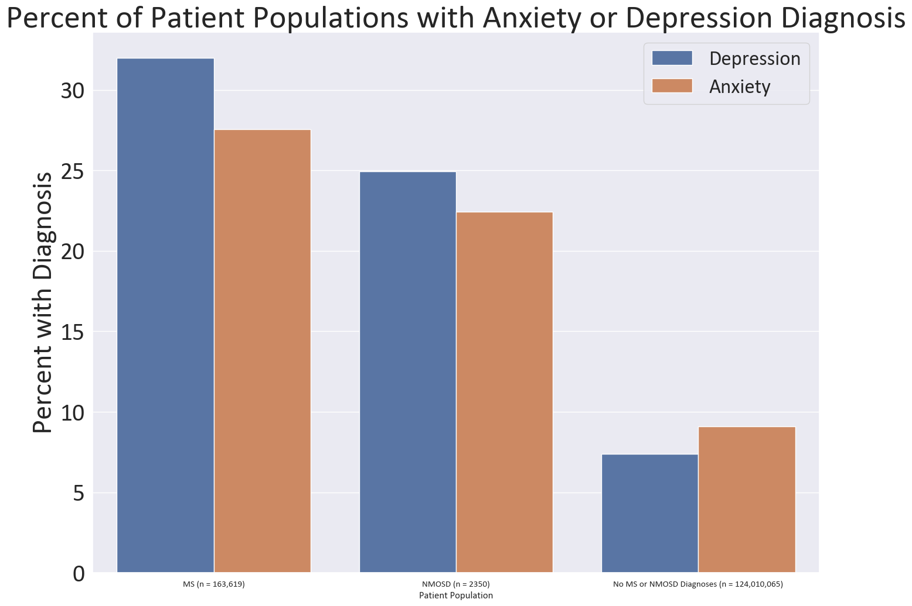
Comparison of Depression and Anxiety in Neuromyelitis Optica Spectrum Disease and Multiple Sclerosis Patients: Analysis of two National Datasets
Abigail H. Sorenson^{1,3}, Esther Zeng^{1,3}, Heewon Hwang², Tammy L. Smith MD, PhD^{3,4,5}, Melissa Wright MD³, Aditi Sharma MD³, Trieste Francis BS³, John Rose MD^{3,4}, Ka-Ho Wong MBA³, Stacey L. Clardy MD, PhD^{3,4}
1. University of California-Berkeley, Berkeley CA, USA 2. Division of biostatistics, University of Utah, Salt Lake City UT, USA. 3. Department of Neurology, University of Utah, Salt Lake City UT, USA. 4. George E. Wahlen Department of Veterans Affairs Medical Center, Salt Lake City, UT. 5. ARUP Laboratories, Salt Lake City, UT
Background
Results
31.98%
Figure 1: Percent of a patient population with a depression or anxiety diagnosis
Neuromyelitis Optica Spectrum Disorder (NMOSD) (~0.5–4/100,000¹) and Multiple Sclerosis (MS) (35.9/100,000²) are both neurological demyelinating diseases
Dearth of literature comparing anxiety and depression for NMOSD patients
Increased prevalence of depression and anxiety are well documented in progressive illnesses³
In literature there is a 13.1% depression prevalence in primary care patients⁴
Table 1: Demographics of Identified Patients
27.56%
 | MS (n = 163,619) |  | NMOSD (n = 2350)
 | Depression 52325 (31.98%) | Anxiety 45095 (27.56%) | Depression 586 (24.94%) | Anxiety 527 (22.43%)
Sex (Female, n(%)) | 41067 (78.48) | 3631 (80.5) | 468 (79.86) | 421 (79.89)
Race n(%) White AI/AN HN/PI Asian Black Unknown | 38885 (74.31) 136 (0.26) 27 (0.05) 224 (0.53) 6151 (11.75) 6902 (13.19) | 344336 (76.14) 132 (0.29) 27 (0.06) 207 (0.46) 4737 (10.51) 5656 (12.54) | 322 (54.94) 3 (0.51) 11 (1.88) 179 (30.55) 71 (12.12) | 311 (59.01) 2 (0.38) 10 (1.9) 154 (29.22) 50 (9.49)
Age at First Diagnosis (Median, [IQR] ) | 50 [39, 60] | 48 [38, 59] | 45 [32, 58] | 42 [29, 55]
24.94%
22.43%
7.4%
9.08%
Objectives
MS (n=163,619)
NMOSD (n=2350)
No MS or NMOSD Diagnosis
(n= 124,010,065)
Ascertain frequency of depression and anxiety in NMOSD and MS patients
Compare demographics between MS and NMOSD depression and anxiety patients
Investigate potential risk factors for depression and anxiety in NMOSD and MS
Patient Population
Table 2: Logistic regression models of demographic odds for being diagnosed with depression
Results Cont.
Odds Ratio [95% CI] | MS Cohort Depression Diagnosis | NMOSD Cohort Depression Diagnosis
Anxiety Diagnosis | 6.423 [6.271, 6.58] *** | 6.809 [5.479, 8.466] ***
Age | 0.982 [0.981, 0.982] *** | 0.981 [0.977, 0.984] ***
Sex (Reference Male) Female | 0.776 [0.757, 0.795] *** | 0.575 [0.466, 0.709] ***
Race (Reference White) AI/AN Asian Black Unknown HN/PI | 0.813 [0.64, 1.031] 0.444 [0.379, 0.521] *** 0.79 [0.763, 0.819] ** 0.677 [0.655, 0.7] * 0.606 [0.37, 0.995] *** | 1.781 [0.352, 8.998] 0.4 [0.201, 0.799] ** 0.715 [0.569, 0.897] ** 0.637 [0.467, 0.869] **
Chi-squared values confirms MS and NMOSD anxiety and depression distribution differences are not by random chance
Depression and anxiety have similar demographic breakdowns in MS and NMOSD cohorts (Table 1)
Logistic models show low odds in racial minorities for reported anxiety and depression (Table 2 & 3)
Depression or anxiety increases risk of developing the other (Table 2 & 3)
Males are less likely to develop anxiety and depression in MS and NMOSD cohorts (Table 2 & 3)
NMOSD and MS cohorts have higher depression and anxiety prevalence rates than the TriNetX population (anxiety: 9.08%, depression: 7.4%) (Figure 1)
Methods
Secondary analysis study with NMOSD and MS de-identified aggregate datasets obtained from TriNetX
TriNetX, a global research network covering 68 US hospital systems which provides access to clinical patient data
Datasets have dates restricted 10/29/1978 – 07/20/2022
To increase specificity patients who had less than three NMOSD ICD-10-CM (G36.0) or MS ICD-10-CM (G35) code entries were removed
ICD-10-CM codes corresponding to anxiety and depression were used to identify anxiety and depression patients
Preformed multivariate logistic regression models to determine demographic odds ratios for developing anxiety or depression as an MS or NMOSD patient
Table 3: Logistic regression models of demographic odds for being diagnosed with anxiety
Odds Ratio [95% CI] | MS Cohort Anxiety Diagnosis | NMOSD Cohort Anxiety Diagnosis
Depression Diagnosis | 8.83 [8.611, 9.061] *** | 9.878 [7.822, 21.478] ***
Age | 0.961 [0.961, 0.962] *** | 0.967 [0.961, 0.969] ***
Sex (Reference Male) Female | 1.486 [1.446, 1.528] *** | 0.909 [0.723, 1.145]
Race (Reference White) AI/AN Asian Black Unknown HN/PI | 1.074 [0.835, 1.383] 0.449 [0.42, 0.593] *** 0.599 [0.576, 0.623] *** 0.664 [0.64, 0.688] *** 0.865 [0.507, 1.477] | 0.704 [0.123, 4.019] 0.398 [0.187, 0.848] * 0.592 [0.462, 0.76] *** 0.385 [0.266, 0.557] ***
Discussion
Limitations of analysis: lack of clinician and disease severity information, datasets originate from an EHR derived database from structure data
The lower odds ration in racial minorities race could be due to underdiagnosis or under examination of marginalized communities
Anxiety and depression should be considered for symptomatic treatment in MS and NMOSD populations given their increased prevalence
p-value < 0.05 * p-value < 0.01 * p-value < 0.0001 ***

Slide 2
Supplement
ICD-10-CM Code Selection
Chi–squared Results
ICD-10-CM codes used to identify anxiety and depression diagnoses
Depression: F33, F33.0, F33.1, F33.2, F33.3, F33.4, F33.40, F33.41, F33.42, F33.8, F33.9, F32.A, F32.8, F32.9, F32.89, F32.0, F32.1, F33.3, F32.5 , F33.42, F32.4, F32.2, F32.3, Z13.31, F43.21, F34.1
Anxiety: F41.9, F41.8, F41.1, F43.22, F41, F43.23, F06.4, F41.3, F41.0, F45.21, F40-F48, F40.10
χ2 = 52.9264 (p <0.00001) | MS (n=163619) | NMOSD (n=2350)
Depression Diagnosis | 52325 | 586
No Depression Diagnosis | 111294 | 1764
χ2 = 30.6532 (p <0.00001) | MS (n=163619) | NMOSD (n=2350)
Anxiety Diagnosis | 45095 | 527
No Anxiety Diagnosis | 118524 | 1823
Using the Chi-squared distribution table both χ2 values are greater than the critical value 10.828 which has the corresponding probability of < 0.001
This confirms a difference in distributions between the MS and NMOSD patients for anxiety and depression
Acknowledgements
Funding was provided by the Sumaira Foundation Spark Grant and Berkeley Student Opportunity Fund
References
Hor JY, Asgari N, Nakashima I, Broadley SA, Leite MI, Kissani N, Jacob A, Marignier R, Weinshenker BG, Paul F, Pittock SJ, Palace J, Wingerchuk DM, Behne JM, Yeaman MR, Fujihara K. Epidemiology of Neuromyelitis Optica Spectrum Disorder and Its Prevalence and Incidence Worldwide. Front Neurol. 2020 Jun 26;11:501. doi: 10.3389/fneur.2020.00501. PMID: 32670177; PMCID: PMC7332882.
Walton C, King R, Rechtman L, Kaye W, Leray E, Marrie RA, Robertson N, La Rocca N, Uitdehaag B, van der Mei I, Wallin M, Helme A, Angood Napier C, Rijke N, Baneke P. Rising prevalence of multiple sclerosis worldwide: Insights from the Atlas of MS, third edition. Mult Scler. 2020 Dec;26(14):1816-1821. doi: 10.1177/1352458520970841. Epub 2020 Nov 11. PMID: 33174475; PMCID: PMC7720355.
Uhlenbusch N, Löwe B, Härter M, Schramm C, Weiler-Normann C, Depping MK. Depression and anxiety in patients with different rare chronic diseases: A cross-sectional study. PLoS One. 2019 Feb 20;14(2):e0211343. doi: 10.1371/journal.pone.0211343. PMID: 30785907; PMCID: PMC6382125.
Jackson JL, Kuriyama A, Bernstein J, Demchuk C. Depression in Primary Care, 2010-2018. Am J Med. 2022 Dec;135(12):1505-1508. doi: 10.1016/j.amjmed.2022.06.022. Epub 2022 Jul 22. PMID: 35878693.

